Slide 1
Date: 23 December 2025

Slide 2



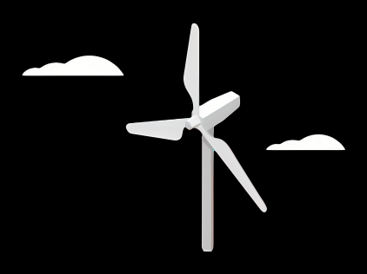
Weekly report: Team Gearbox, Brake, Coupling
Week number : 13
Date: 23/12/2025
Supervisor: Prof. Peter Quell
Group Members :Nehang Jitendra Joshi,Santo Mazumder,Md Razaul Karim Rahat
Presented by - Nehang Jitendra Joshi
23-12-2025
Gearbox, Brake, Coupling

Slide 3
List of Content
Gearbox calculation and design
Weight and Cost calculations
23-12-2025
Gearbox, Brake, Coupling

Slide 4
Gearbox parameter calculation –Updated planetary stages 1st and 2nd
Parameter | 1st stage and 2nd stage | 3rd stage
Ratio | 4.8 and 4.92 | 5.1
Module | 16 and 14 | 12
PCD Ring | 1904 mm and 1428 mm | NA
PCD gear | NA | 1284 mm
PCD pinion | NA | 312 mm
Center distance | NA | 798 mm
No planet | 5 and 4 | NA
23-12-2025
Gearbox, Brake, Coupling

Slide 5
Gearbox parameter
Parameter
Total width of the gearbox | 3200 mm
Total length of the gearbox | 1540 mm
Total ratio | 120
Pin to pin distance | 2700 mm
Dia of the gearbox | 2100 mm
Stages of the gearbox | 3
Efficiency | 0.97 %
23-12-2025
Gearbox, Brake, Coupling

Slide 6
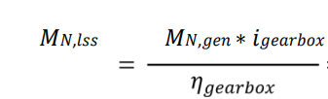
Gearbox Torque calculation
Torque transfer
These values considered the losses of the different electrical components like generator, converter, and transformer. From this torque and the efficiency (97%) and ratio (120) of the gearbox, the nominal torque at the low-speed shaft 𝑀𝑁,𝑙𝑠𝑠 can be calculated as following
41.9 *120 / 0.97 = 5,183.50 KNm
Torque overload protection
For this, a breakdown torque of the coupling of 2.5 times the nominal torque is required by industry experience. The components behind the coupling are designed to withstand a higher torque than this breakdown torque, so that the coupling will fail first and the other components are protected in cases of overloads.
Mn,lss * 2.5 = 12,958.75 KNm - Breakdown
23-12-2025
Md Razaul Karim Rahat
Gearbox, Brake, Coupling

Slide 7
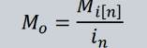
Gears geometry calculation
Parameter | Formula | 1st stage | 2nd stage | 3rd stage
Input torque |  | 5183.50 | 5276.90 | NA
Output torque |  | 5276.90 | 5,769.791667 | NA
Pitch diameter,d (mm) | m*zp m*zs m*zr | dr-1904 mm | dr-1428 mm | 1200 and 336
Outer dia ,Do (mm) | D0=(z+2).m | dr-1964 mm | dr-1488 mm | NA
Addendum,a(mm) | a=m | 16 | 14 | 2
Dedendum,b(mm) | b=1.25*m | 20 | 17.5 | 11.25
Face width,(mm) | 10 * module | 160 | 140 | 120
23-12-2025
Gearbox, Brake, Coupling

Slide 8
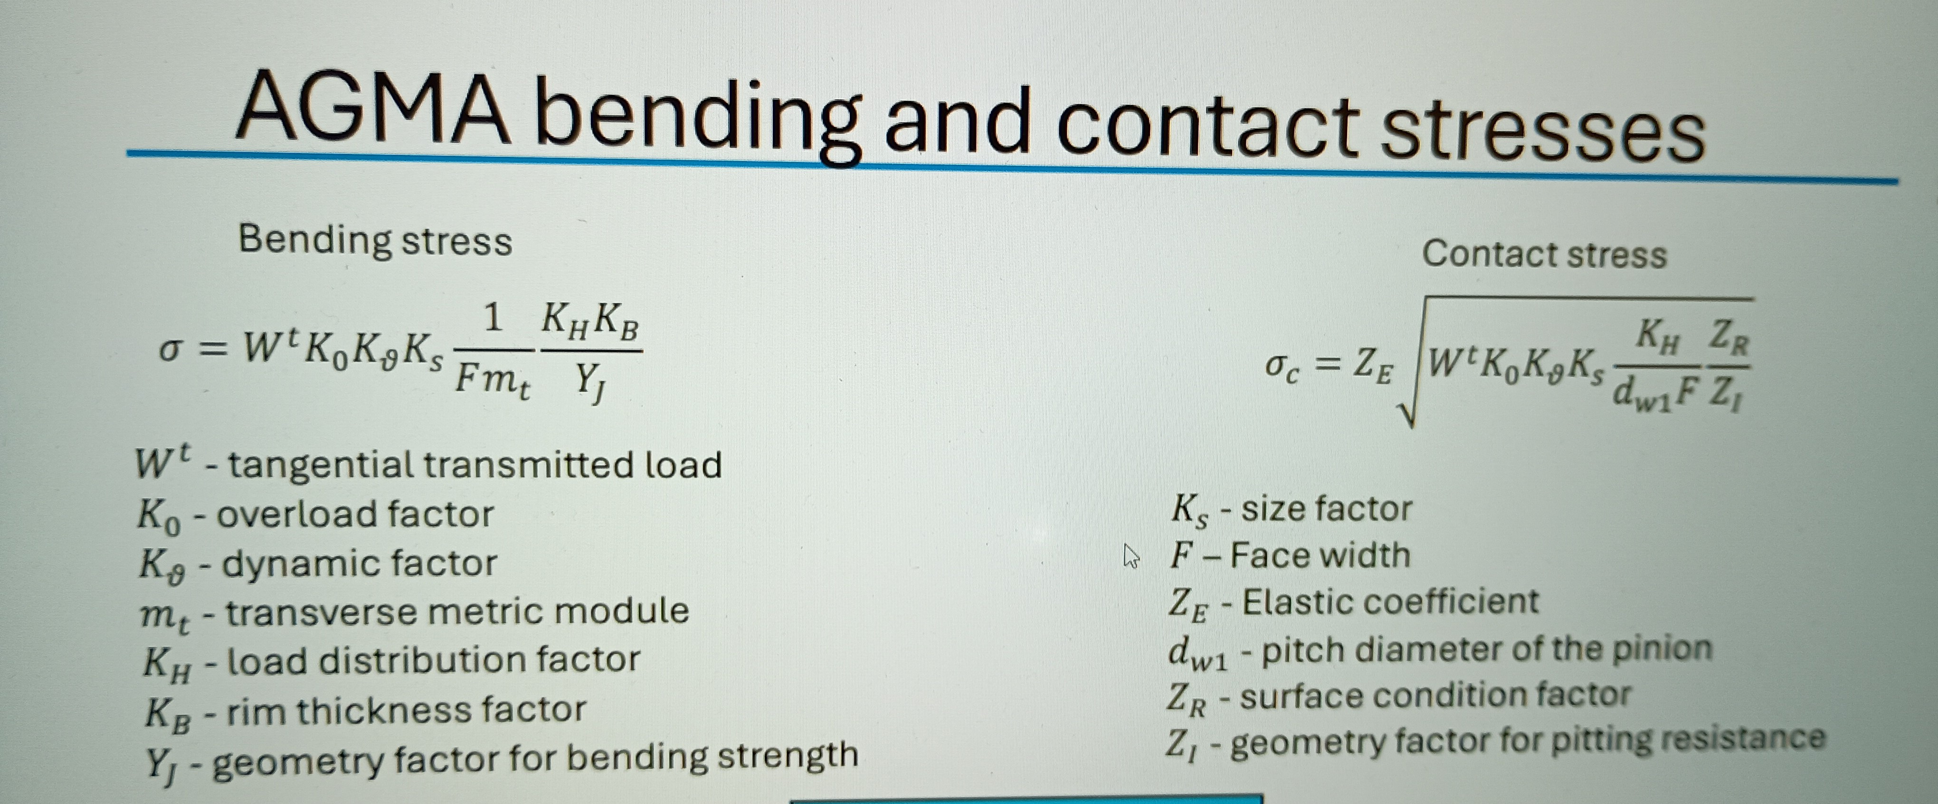
Bending and contact stress for gears
23-12-2025
Gearbox, Brake, Coupling

Slide 9
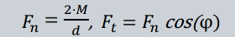

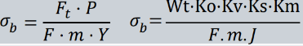
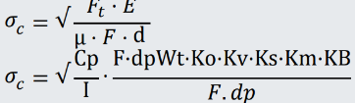
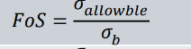
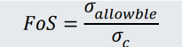
Force analysis, Stress, and Safety Factors (Zr-Ring gear)
Parameter | Formula | 1st stage | 2nd stage
Input torque,M (MNm) | Mi-5183.50 M2=M1/i1 | 5183.50 | 1018.80
Tangencial force,Ft (MN) |  | 5.45 | 1.29
Radial force Fr (MN) |  | 3.49 | 1.09
Bending stress (m (MPa) |  | 120.89 | 80.90
Contact stress C,(MPa) |  | 190.57 | 160.62
Factor of safety (Bending) |  | 4.35 | 3.2
Factor of safety (Contact) |  | 1.40 | 1.90
23-12-2025
Gearbox, Brake, Coupling

Slide 10
Bending and contact stress for gears
Parameter | 1st stage | 2nd stage
Bending factor,SF | 4.35 | 3.2
Contact factor,SH | 1.40 | 1.90
SF min ≥ 1.56 and SH min ≥ 1.25
23-12-2025
Gearbox, Brake, Coupling

Slide 11
Gearbox elastomeric calculation
Parameter | Values
Power main shaft | 550 KW
Rpm | 5183.50
Teeth on sun gear | 31
Teeth on ring gear | 119
Distance between torque arm | 3200 mm
Torque on carrier | 380098 Nm
Torque on sun gear | 98783 Nm
Parameter | Values
Torque on ring gear | 314800 Nm
Dia of the pin inner | 300 mm
Dia of pin outer | 400 mm
No of planet 1st stage | 5
Shar stress | 21.8 Mpa
Bending stress | 11.9 Mpa
Tensile stress | 37.8 Mpa
23-12-2025
Gearbox, Brake, Coupling

Slide 12
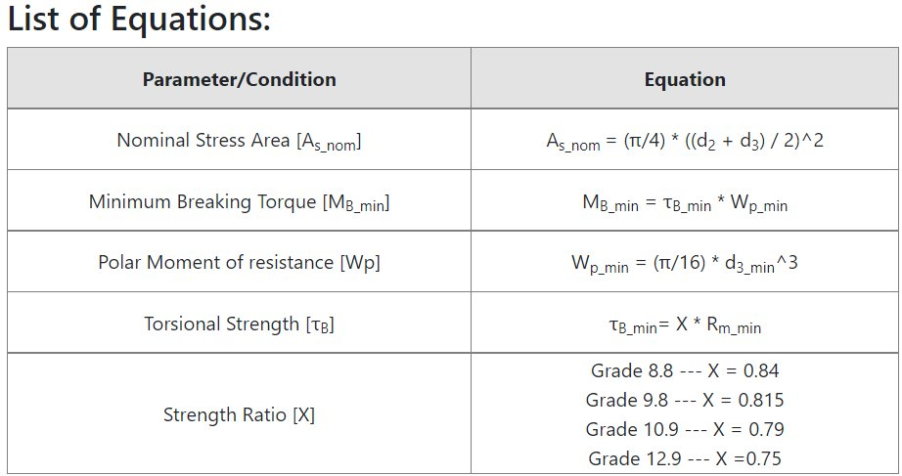
Elastomeric bolts selection
23-12-2025
Gearbox, Brake, Coupling

Slide 13
Elastomeric bolts selection M48
Parameter
Designation | M48
Property class | 12.9
Screw thread series | Coarse
Nominal stress area | 1473 mm^2
Min tensile strength | 1220 Mpa
Min ultimate tensile load | 2180000 N
Minimum stress | 1220 Mpa
Parameter
Stress under proff load | 2134 Mpa
Proff load | 1430 KN
An M48 Grade 12.9 bolt is an ultra-high-strength fastener used where extreme reliability is needed. Its material can handle immense tension (pulling apart) and shear (sliding apart) forces, making it suitable for engine components, heavy equipment, and aerospace, with a substantial clamping force generated when tightened correctly.
23-12-2025
Gearbox, Brake, Coupling

Slide 14
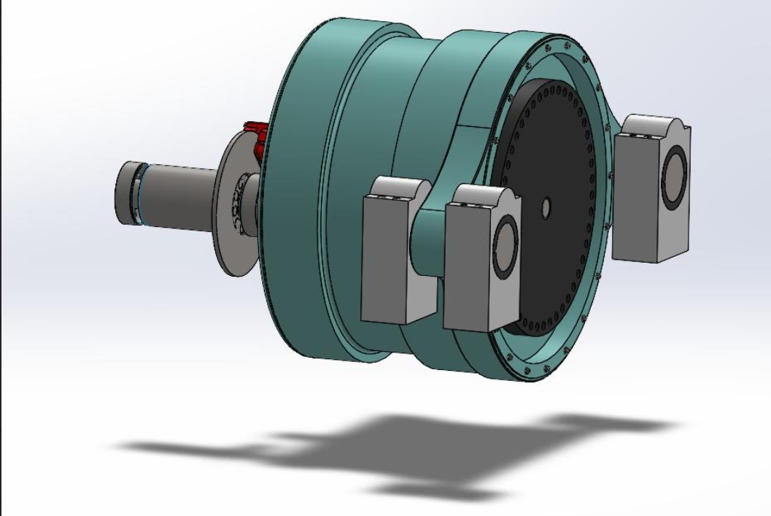
3D model Gearbox-Updated
Parameter
Ratio | 120
Stages | 3
Length | 1540 mm
Width | 3200 mm
Pin to pin distance | 2700 mm
Reference: Own design
23-12-2025
Gearbox, Brake, Coupling

Slide 15
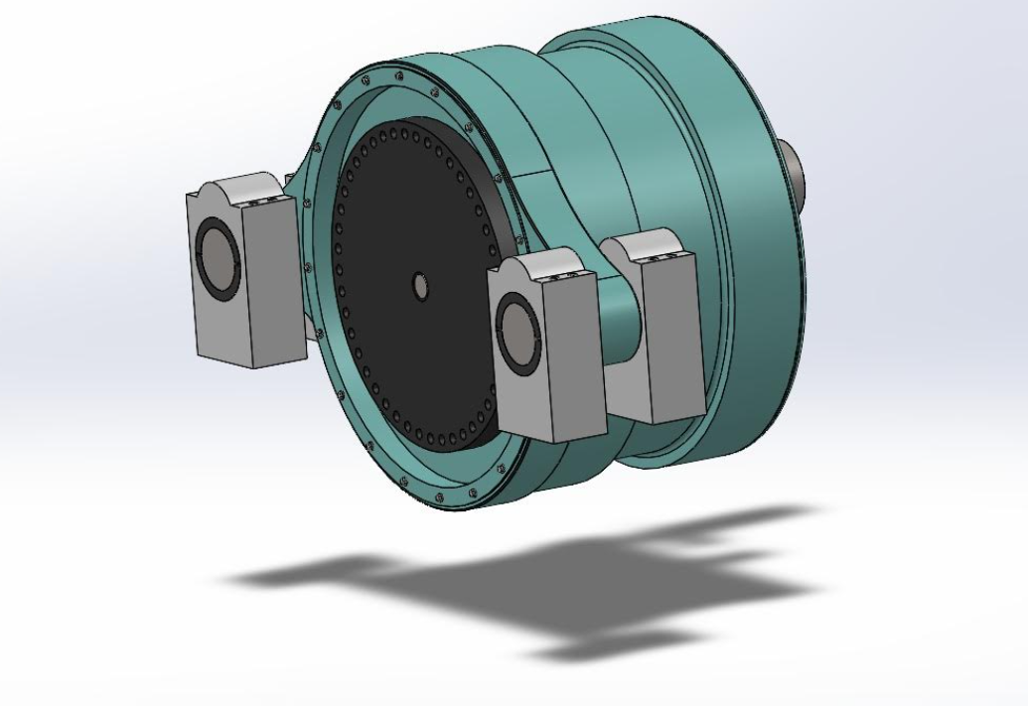
3D model Gearbox
Reference: Own design
23-12-2025
Gearbox, Brake, Coupling

Slide 16
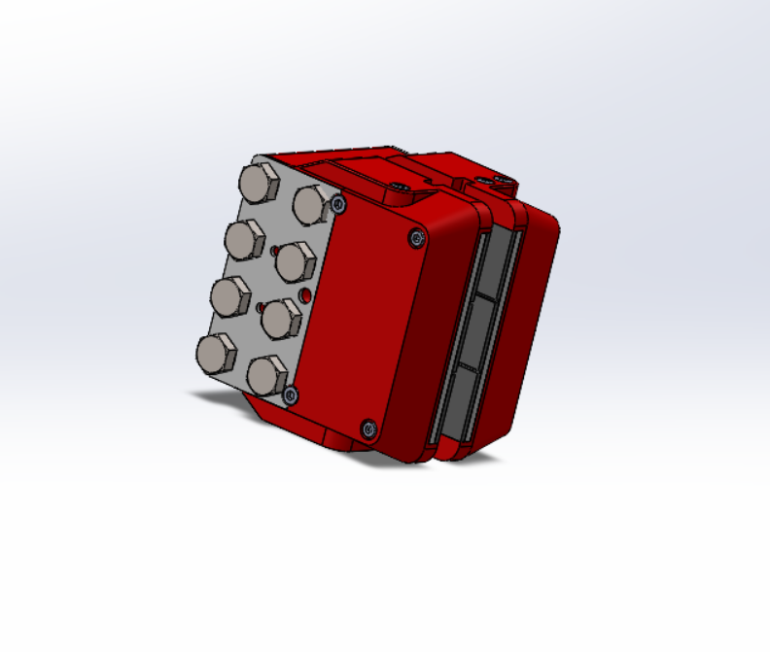
3D model Brake
Parameter
Type | Svendborg 300 dual action
Length | 220 mm
Width | 167 mm
Weight | 62 Kg
Reference: Own design
23-12-2025
Md Razaul Karim Rahat
Gearbox, Brake, Coupling

Slide 17
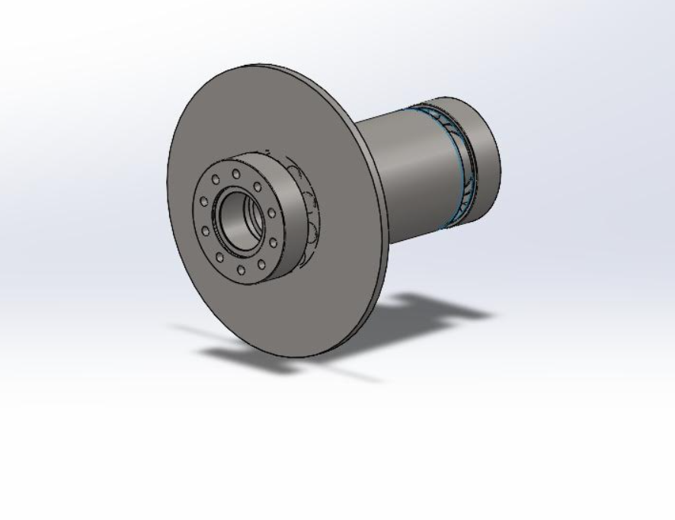
3D model Coupling
Parameter
Model | KTR RADEX NANA
Length | 945 mm
Disc Radius | 450 mm
Weight | 170 Kg
Reference: Own design
23-12-2025
Gearbox, Brake, Coupling

Slide 18
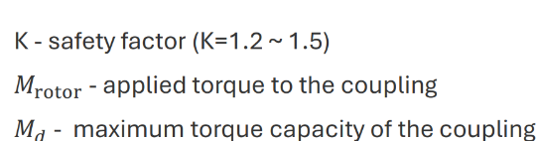
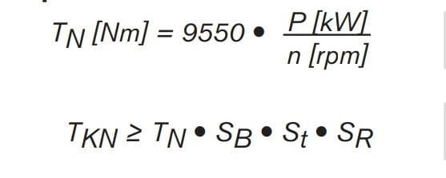
Coupling Torque calculation
Coupling
Calculate the compensating torque applied to the coupling
Md=Md rotor * K = 5,095* 1.5 =7.6425 MNm
Nominal Torque = 3,979.16 Nm
T_{kN} = 5,769.791667 Nm, On Considering Size Factor as 1.45
According to the Calculated Torque , The size of the High-speed shaft side could be chosen as 115mm With 6 Holes
23-12-2025
Gearbox, Brake, Coupling

Slide 19
Weight and Cost
No | Components | Weight estimation | Cost estimation
1 | Gearbox | 11600 Kg | 1160056 €
2 | Elastomeric bearing | 58 Kg | 261 €
3 | Brake caliper | 62 Kg | 279 €
4 | Coupling | 170 Kg | 765 €
Total Weight | 11,990 Kg
Total cost | 1,161456 €
Source-https://www.indexbox.io/search/cast-iron-price-per-kg
23-12-2025
Gearbox, Brake, Coupling

Slide 20
Bibliography
Gearbox
Previous year Optimus projects(60E,92LE,Shakti 14-12-2025
Roloff Matek Maschinenelemente 14-12-2025
Lecture notes – Mechanical drive train by Prof.Peter Quell.13-12-2025
Shigley's mechanical engineering design and PSG data book 12-12-2025
DNV and IEC-61400-4 guidelines 13-12-2025
23-12-2025
Gearbox, Brake, Coupling

